Slide 1
Time
Time of Year (TOY)
Unix Time
Bash commands for Unix Time
Unix time milestones
CPU time – Higher resolution
Measuring time taken for processing
Seconds since midnight
Leap seconds
Python ephemeris module
Converting Ephem time to Unix time
Converting Unix time to Ephem time
Demonstration of sun information program
Waikato Linux Users Group
28 August 2017
Ian Stewart

Slide 2
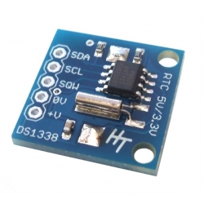
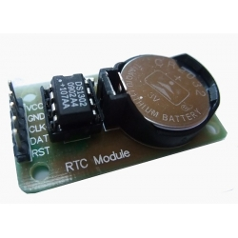
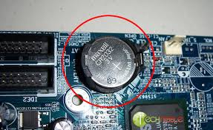
Time of Year (TOY) Clock
Real Time Clock – Maintained with battery during power off.
RTC Counts Seconds, Minutes, Hours, Date of the Month, Month, Day of the Week, and Year with Leap-Year valid up to 2100
Integrated Circuit. E.g. DS1338, DS1302, DS1307, DS3234, etc.
Low current draw.
Oscillator using external 32.768kHz crystal.
PC’s typical battery 2032
RTC for Raspberry Pi
http://www.hobbytronics.co.uk/real-time-clock-ds1338
DS1338 Datasheet
https://datasheets.maximintegrated.com/en/ds/DS1338-DS1338Z.pdf

Slide 3

Unix Epoch Time
Unix time / POSIX time / Epoch time is a system for describing instants in time.
The number of seconds that have elapsed since 00:00:00 Coordinated Universal Time (UTC), Thursday, 1 January 1970.
Minus the number of leap seconds that have taken place since then.
Unix time about to hit 1 billion in Denmark (+2 UTC)
Unix time
https://en.wikipedia.org/wiki/Unix_time

Slide 4
Bash commands for Unix Time
$ date
Mon Aug 28 14:38:09 NZST 2017
$ date +%s
1503887892
$ date; date +%s
Mon Aug 28 14:47:17 NZST 2017
150388843
$ date --date="@0" --utc
Thu Jan 1 00:00:00 UTC 1970

Slide 5
Unix Time milestones
$ date --date="@0"
Thu Jan 1 12:00:00 NZST 1970
$ date --date="@1000000000" --utc
Sun Sep 9 01:46:40 UTC 2001
$ date --date="@-1000000000"
Mon Apr 25 09:43:20 NZMT 1938
$ date --date="@1500000000"
Fri Jul 14 14:40:00 NZST 2017
$ expr $((2**31))
2147483648
$ date --date="@2147483648"
Tue Jan 19 16:14:08 NZDT 2038
No Daylight savings in NZ in 1970?
32 Bit time comes to an end in NZ

Slide 6
CPU Clock – Higher Resolution
The CPU clock used by the Linux OS for internals.
$ time wget www.guardian.co.uk --quiet
real 0m1.996s
user 0m0.036s
sys 0m0.024s
$ python
>>> import time
>>> time.time()
1503891249.5765698
Unix time
plus
floating point value of part of a second.

Slide 7
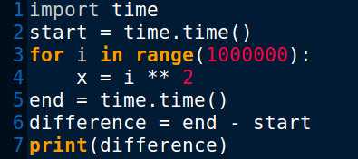
CPU Clock – Higher Resolution
$ python3 time_delay.py
0.7522392272949219
Increase looping from 1 million to 10 million
$ python3 time_delay.py
7.54260778427124
Part of a second.

Slide 8
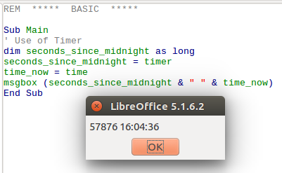
Seconds since midnight.
Seconds since midnight. E.g. LibreOffice Basic “timer”

Slide 9
Leap Seconds
Because of irregularities in the Earth's rate of rotation, a one-second adjustment that is occasionally applied to Coordinated Universal Time (UTC) in order to keep its time of day close to the mean solar time, or UT1.
Implemented in 1972
If required applied 30 June or 31 December.
Since 1972: 27 leap seconds applied.
Leap Seconds
https://en.wikipedia.org/wiki/Leap_second

Slide 10
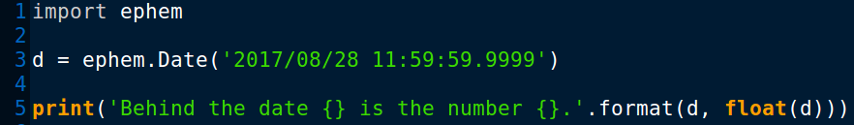
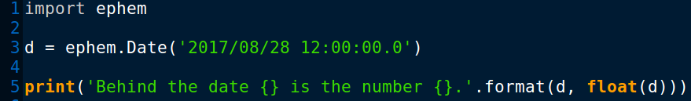
Python ephemeris module
Ephem module. http://rhodesmill.org/pyephem/index.html
From: Ephemeris (Related to Astronomy Astrology)
A table or data file giving the calculated positions of a celestial object at regular intervals throughout a period.
Python ephem time with an epoch of 31 Dec 1899 12:00:00.
Floating point value of days and part of a day.
$ python3 ephem_demo.py
Behind the date 2017/8/28 12:00:00 is the number 42973.99999999884.
$ python3 ephem_demo.py
Behind the date 2017/8/28 12:00:00 is the number 42974.0.

Slide 11
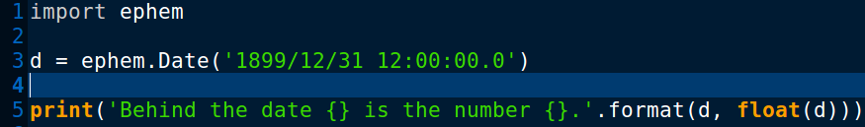
Python ephemeris module
Python ephem time with an epoch of 31 Dec 1899 12:00:00.
.
$ python3 ephem_demo.py
Behind the date 1899/12/31 12:00:00 is the number 0.0.
$ python3 ephem_demo.py
Behind the date 1899/12/30 00:00:00 is the number -1.5.
$ python3 ephem_demo.py
Behind the date 1900/1/1 00:00:00 is the number 0.5.

Slide 12
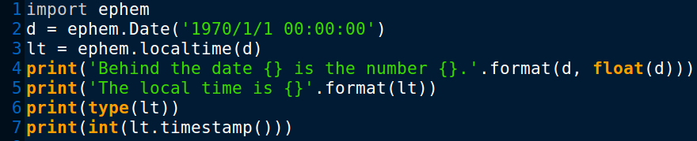
Converting Ephem time to Unix time
Takes a PyEphem date and return a Python datetime giving your local time.
$ python3 ephem_demo.py
Behind the date 1970/1/1 00:00:00 is the number 25567.5.
The local time is 1970-01-01 12:00:00.000003
<class 'datetime.datetime'>
0
Unix epoch time

Slide 13
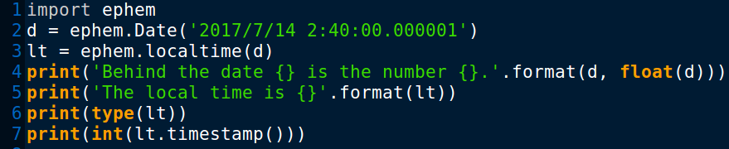
Converting Ephem time to Unix time
Takes a PyEphem date and return a Python datetime giving your local time.
Add 0.000001 to fudge the rounding error
$ $ python3 ephem_demo.py
Behind the date 2017/7/14 02:40:00 is the number 42928.611111111124.
The local time is 2017-07-14 14:40:00.000004
<class 'datetime.datetime'>
1500000000

Slide 14
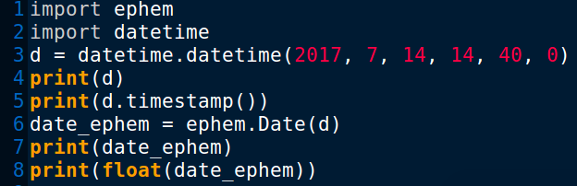
Converting Unix time to Ephem time
$ python3 ephem_demo.py
2017-07-14 14:40:00
1500000000.0
2017/7/14 14:40:00
42929.11111111112
Unix time
Ephem time

Slide 15
Demo – Ephem / Unix time – Sun Info
$ python3 sun_info.py -s
The date is Monday, 28 August 2017.
The time is 10 hours, 9 minutes and 37 seconds.
The previous sunrise was 2017-08-28 6:46:11
The previous sunset was 2017-08-27 17:53:27
The next sunrise is 2017-08-29 6:44:46
The next sunset is 2017-08-28 17:54:17
The solar noon for today at 12:20:16
Today's solar noon altitude angle 42.2 degrees.
The sun's current altitude is 33.6 degrees.
The sun's current azimuth is 39.6 degrees.

Slide 16
Demo – Ephem / Unix time – Sun Info
$ python3 sun_info.py -s
Status of Observer of the Sun.
Location: Nevada Road, Hamilton, New Zealand.
Date UTC: 2017/8/27 22:09:37
Latitude: -37:47:10.6
Longitude: 175:19:55.2
Elevation: 40.0
Horizon: 0:00:00.0
Epoch: 2000/1/1 12:00:00
Temperature: 10.0
Pressure: 1010.0

Slide 17
The End of Time.

